Slide 1
Optimizing Oracle Service Bus Developer Tools and Workflow A University of Colorado Case Study

Slide 2
Agenda
Purpose
Tools & Plugins Summary
Demonstration of Developer Workflow
High-level Flow
Retrieving Projects and Dependencies
Tokenizing Environmental References
Building JAR file
Deploying to OSB Local or shared Dev
Unit Testing
Demonstration of Deployment Workflow
Deploying to OSB Test, Prep, and Prod
Continuous Integration Testing (Automated)
Functional Testing
Migration
Gotchas & Tips
Q&A

Slide 3
Purpose
Why a VM?
Developer Efficiency
Fast Onboarding
Repeatability/Reliability
Constantly Breakable (and fixable!)
Disconnected Development & Testing
Automated Deployments
Continuous Integration
Automated Test Execution/Reporting
Cross-Team Migration Efficiency

Slide 4
Tools & Plugins Summary
OSB Core Components
OEPE 11.1.1.8.0
OSB 11.1.1.6.0
Weblogic 10.3
Java JRE/JDK
Python 2.7.3

Slide 5
Tools & Plugins Summary
Eclipse Plug-ins
Mylyn 3.8.2 (for JIRA)
Subclipse 1.6 Plugin
SoapUI 4.0.1 Plugin

Slide 6
Tools & Plugins Summary
Build/Dependency Tools
Ant 1.8.4
Ant Contrib 1.0b3
Ant Forms 2.0
Ivy 2.3.0

Slide 7
Tools & Plugins Summary
VM Accessories
Notepad++
JDeveloper
IntelliJ
SQL Developer
Oxygen
Your favorite Text/Code/XML Editor(s)

Slide 8
Tools & Plugins Summary
Integration & Deployment
Jenkins v1.494
LDAP Plugin
Subversion Plugin
EnvInject Plugin
Workspace Cleanup Plugin
ChuckNorris Plugin

Slide 9
Workflow Overview
OSB Test
SVN
Auto/CI
Developer
VM
R/W
R
Jenkins
OSB Prep
On Demand
Ivy
R
R/W
On Demand
OSB Prod
OSB Local
OSB Dev
Development
Deployment

Slide 10
Developer Workflow
High-Level Flow
OSB Project code retrieved from SVN
Ivy – Version & Dependency Management
Ant – Tokenizing & Build Execution
ConfigExport Utility to create JAR
WLST and Python to deploy JAR
SoapUI – Unit Testing

Slide 11
Developer Workflow
Retrieving Projects and Dependencies
Check out project from SVN
Dependencies are defined in ivy.xml
Versions are archived separately
Ivy promises dependencies appear in /lib/ folder
Right-click->Import if necessary to resolve Errors, OR
Check out project via SVN if changes required

Slide 12
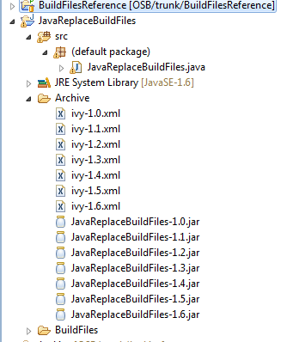
Ivy – archives all versions

Slide 13
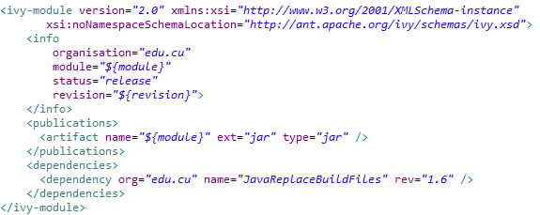
ivy.xml

Slide 14
Ivy Retrieval
Reads ivy.xml to find <dependencies>
Retrieves all dependencies (and chains of dependencies) to /lib/
Ant target (in Build.xml):
<target name="IvyPull">
<delete failonerror="true" dir="${library.dir}"/>
<ivy:cleancache />
<ivy:resolve />
<ivy:retrieve />
</target>

Slide 15
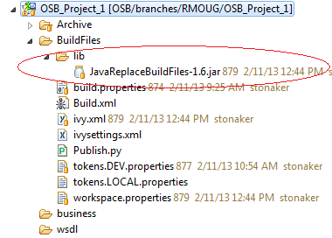
/lib/
Either right-click on JAR and Import into workspace, or
Find the same-name project in SVN and Checkout
Using the first method, you can always be guaranteed to disconnect and go, without needing to search for any dependencies prior to going offline.

Slide 16
project.properties
module=OSB_Project_1
revision=1.0
export.projects=OSB_Project_1
debug=false
publish.preserve.settings=false
replacetokens=true
replacetokens.sourcefolders=wsdl
replacetokens.filetypes=wsdl
replacetokens.outputfolder=output
replacetokens.foldernamesreplace=,
replacetokens.renamesourcefiles=true

Slide 17
Developer Workflow
Tokenizing Environmental References
Developer defines “tokens” to represent:
A URL
Server names
Any “environment-level” variable
Token values are defined for all environments
Java helper class to find/replace tokens during build
Helper class included in JAR via Ivy
Invoked by Ant target

Slide 18
tokens.LOCAL.properties
[Environment]
wls.server=Developer-PC:7001
wls.username=weblogic
wls.domain=base_domain
wls.cluster=OSB_Cluster_1
osb.config.project=OSBConfigurationLOCAL
tokensfilename=tokens.LOCAL.properties
[Tokens]
token.ENVIRONMENT=OSB-LOCAL-VM
token.OSBSERVER=Developer-PC:7003

Slide 19
Helper: JavaReplaceBuildFiles
String Find/Replace with a little extra polish
// Arg 0: Comma-delimited list of source folders to scan
// Arg 1: Comma-delimited list of file types to scan
// Arg 2: Target output folder (will be created if not already exists)
// Arg 3: Path to properties file that contains the tokens to be found/replaced
// Arg 4: Comma-delimited list of strings to be replaced with the outputfolder name instead
// (This helps catch any oversights whereby something is referencing an original (still-tokenized) file, instead of the output file that has had the tokens replaced.)
// Arg 5: True/False debug flag (controls log output)
// Arg 6: Absolute path to the project folder (the expected parent of source folders and outputFolder)
// Arg 7: Flag that governs whether source tokenized files get renamed as .replaced

Slide 20
Using JavaReplaceBuildFiles
Example of using this JAR in Ant with the local VM:
<target name="ReplaceBuildFiles">
<java fork="true"
failonerror="true"
maxmemory="16m"
classname="JavaReplaceBuildFiles"
classpath="lib/JavaReplaceBuildFiles-1.6.jar">
<arg line="${replacetokens.sourcefolders}" />
<arg line="${replacetokens.filetypes}" />
<arg line="${replacetokens.outputfolder}" />
<arg line="./tokens.LOCAL.properties" />
<arg line="${replacetokens.foldernamesreplace}" />
<arg line="${debug}" />
<arg line="C:/workspace/projectName" />
<arg line="true" />
</java>
</target>
The above ${…} properties are defined in the project.properties file

Slide 21
Build OSB Configuration JAR
Invoked by Ant target
Retrieves dependencies from Ivy
Cleans and creates new workspace
Builds JAR file specific to target environment
Syncs to Ivy, uploads new version

Slide 22
Create New Workspace
Create new scratch workspace folder to run build
Copy current workspace (or specific target projects) to scratch workspace
Delete and recreate /.metadata/ folder in the scratch workspace
Fix OSBConfiguration/.settings/com.bea.alsb.core.prefs
container.referenced.projects=
Pipe-delimited list of projects that are ‘attached’ to this OSB Configuration project

Slide 23
Ant Target: ConfigExport (create JAR)
jar="${eclipse.home}/plugins/org.eclipse.equinox.launcher_1.2.0.v20110502.jar
Installed with Eclipse
Oracle-provided Ant targets

Slide 24
Ivy Publish
<ivy:publish overwrite="true" update="true" forcedeliver="true" resolver="cuivyrepo" module="${module}" revision="${revision}">
<artifacts pattern="${workspace.export.config.dir}/[artifact]-[revision].[ext]"/>
</ivy:publish>

Slide 25
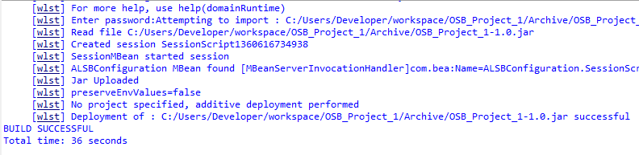
Publish JAR to OSB
<wlst fileName="./Publish.py" … >
<script>
adminUser=sys.argv[1]
adminPassword=sys.argv[2]
adminUrl=sys.argv[3]
passphrase = sys.argv[2]
project=sys.argv[4]
importJar=sys.argv[5]
customFile=sys.argv[6]
preserveEnvValues=sys.argv[7]
connect(adminUser,adminPassword,adminUrl)
domainRuntime()
</script>
</wlst>

Slide 26
Developer Workflow
Deployment
Scripting OSB Objects (WM, JMS, etc)
Based on Record functionality in WLS Console
Python script invoked via Ant
Parameters passed from config values specific to target environment (defined in tokens files)

Slide 27
Ant Target: CreateOsbObjects
<wlst fileName="./CreateOSBObjects.py" debug="${debug}" failOnError="true" arguments="${wls.username} ${wls.password} ${wls.server} ${wls.domain} ${wls.cluster}">
<script>
adminUser=sys.argv[1]
adminPassword=sys.argv[2]
adminUrl=sys.argv[3]
domainName=sys.argv[4]
clusterName=sys.argv[5]
</script>
</wlst>

Slide 28
OSB Object Creation Python wrapper
Python wrapper around Recorded code from Console
Provides various environment–level variables
From build process
From environment properties files
Developer must replace hard-coded server/cluster names, etc

Slide 29
Developer Workflow
Unit Testing
SoapUI plug-in for Eclipse
Multiple TestSteps in a TestSuite
Write Asserts with Jenkins automation in mind!

Slide 30
Developer Workflow
Deployment
Invoked by Ant target
Using Python for WLST scripting
Builds JAR file specific to target environment using environment tokens
Can publish to Localhost or Development
Must Commit to SVN to start Testing & Migration process

Slide 31
Same Target, different properties
<target name="_CleanBuildAndPublishDEV">
<property file="./tokens.DEV.properties" />
<antcall target="CleanBuildAndPublish"/>
</target>
<target name="_CleanBuildAndPublishLOCAL">
<property file="./tokens.LOCAL.properties" />
<antcall target="CleanBuildAndPublish"/>
</target>

Slide 32
VM Demo
New Developer Setup
Ivy Dependencies
Token Replacement
OSB Object Creation
Deployment

Slide 33
Workflow Overview
OSB Test
SVN
Auto/CI
Developer
VM
R/W
R
Jenkins
OSB Prep
On Demand
R/W
Ivy
R
On Demand
OSB Prod
OSB Local
OSB Dev
Development
Deployment

Slide 34
Developer Workflow
Migration
Jenkins server acts as gatekeeper to QA & Production environments
Continuous Integration every SVN Commit to a dedicated Test environment
Targeted project-by-project deployments to QA and Production environments

Slide 35
Gotchas & Tips
Execute build in a separate [empty] workspace!
Be sure to start OSB Managed server in VM
If on Linux/Unix, add jenkins user to oracle group
Underscores in tokens will fail some OSB Validations
Periods in tokens do not work at all
Use dos2unix liberally if running Jenkins on Linux
Again: run builds in a separate workspace (really!)

Slide 36
Presentation Resources
RMOUG website
https://github.com/stonaker/cu-presentations
Folder /RMOUG_Optimizing_OSB_Developer_Tools/
This Slideshow
Setup/Installation Document
Sample Code
Properties files examples
Tokens file examples
Sample Ant targets
Java Tokenizer class
Eclipse environment setup shell scripts

Slide 37
Special Thanks
Eric Greenfeder & the Visual Integrator team
www.visualintegrator.com
www.thefusionexperts.com

Slide 38
Q&A
Anthony Stonaker
University of Colorado
anthony.stonaker@cu.edu

